Slide 1
Radiation & Cancer Biology Course for Residents (Part 2) Boards Review Questions

Slide 2
Oxygen Effect & Tumor Hypoxia (cont.)

Slide 3
The HIF-1 transcription factor is stabilized under hypoxic conditions because of:
A. increased activity of VHL.
B. increased transcription of HIF-1α.
C. reduced stability of HIF-1β.
D. reduced hydroxylation of HIF-1α.

Slide 4
All of the following processes are regulated by HIF-1, EXCEPT:
A. angiogenesis.
B. EPO production.
C. glycolysis.
D. p53 activation.
E. pH regulation.

Slide 5
Which protein causes the rapid degradation of HIF-1α under well-oxygenated conditions?
A. phosphoinositide 3-kinase (PI3K)
B. Von-Hippel Lindau (VHL)
C. hypoxia inducible factor β (HIF-1β)
D. carbonic acid anhydrase (CA-9)

Slide 6
HIF-1 signaling metabolically reprograms cancer cells by:
A. up-regulating glucose transporters.
B. increasing oxidative phosphorylation.
C. increasing conversion of pyruvate to acetyl-Co A.
D. decreasing glycolysis.

Slide 7
True-False Questions:
Patients with cervix tumors having low median values of pO₂ show reduced 5-year survival following radiotherapy alone.
True
Patients with cervix tumors having low median values of pO₂ show reduced 5-year survival following surgery alone.
True
Hypoxia is a selective pressure for more aggressive tumor cell phenotypes.
True

Slide 8
True-False Questions (cont.):
HIF-1α is constitutively active and bound to the promoters of hypoxia responsive genes.
False
In patients with von Hippel-Lindau syndrome, HIF-1α is active even under well-oxygenated conditions.
True

Slide 9
Radiosensitizers & Radioprotectors

Slide 10
How would the addition of a radiosensitizer affect the radiation dose response curve for tumor control probability?
A. shift curve to the right, toward higher doses
B. shift curve to the left, toward lower doses
C. shift curve upwards, toward higher tumor control probabilities
D. shift curve downwards, toward lower tumor control probabilities

Slide 11
Which hypoxic cell radiosensitizer or hypoxic cytotoxin correctly matches its description?
A. Etanidazole – hypoxia specific cytotoxin
B. Tirapazamine – nitroimidazole radiosensitizer
C. Misonidazole – detected in tumors using MRI
D. Nimorazole – hypoxic cell sensitizer combined with radiation to treat certain head and neck cancers

Slide 12
Bioreductive drugs such as tirapazamine help eliminate hypoxic cells in tumors by:
A. incorporating into their cellular DNA
B. protecting aerobic cells so that higher radiation doses can be delivered safely
C. killing them
D. substituting for oxygen in free radical reactions
E. inhibiting sublethal damage recovery

Slide 13
Which radiosensitizer depends on the presence of rapidly proliferating cells for its action?
A. hyperbaric oxygen
B. misonidazole
C. 5’-bromodeoxyuridine
D. Fluosol DA®
E. amifostine

Slide 14
Which treatment would be best at protecting against or mitigating late normal tissue injury after radiotherapy?
A. amifostine, given 4 hours after each dose
B. palifermin, given just prior to each dose
C. pentoxifylline, given for 8-10 weeks after irradiation
D. vitamin C, given daily during radiotherapy

Slide 15
Drugs such as misonidazole radiosensitize hypoxic cells by:
A. incorporating into their cellular DNA
B. protecting aerobic cells so that higher radiation doses can be delivered safely
C. killing them
D. substituting for oxygen in free radical reactions
E. inhibiting sublethal damage recovery

Slide 16
Amifostine does not radioprotect:
A. bone marrow
B. brain
C. esophagus
D. lung
E. salivary gland

Slide 17
Which agent can be used to help mitigate radiation-induced oral mucositis?
A. amifostine
B. metformin
C. palifermin
D. pentoxifylline

Slide 18
How should hyperthermia and radiation be combined to produce the most radiosensitization?
A. hyperthermia one hour before RT
B. hyperthermia one hour after RT
C. delivered simultaneously
D. delivered on alternating treatment days

Slide 19
For conventional fractionation, the tolerance dose for a particular normal tissue complication is 30 Gy. If a patient is treated with a drug that has a dose reduction factor of 1.3, then the new tolerance dose for this tissue should be about:
A. 23 Gy.
B. 30 Gy.
C. 33 Gy.
D. 36 Gy.
E. 39 Gy.

Slide 20
Angiogenesis & Metastasis

Slide 21
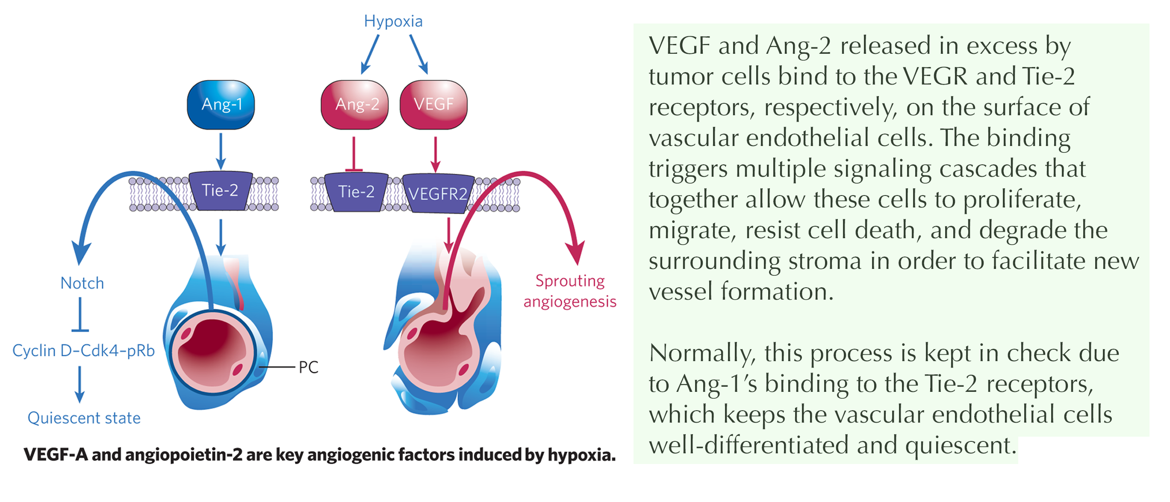
Which angiopoetin is associated with the immature, dysfunctional blood vessels of tumors?
a. Ang1
b. Ang2
c. VEGF
d. Tie2
e. TIMP-1

Slide 22
Which statement concerning vasculogenesis is TRUE? Vasculogenesis:
A. is only relevant during embryological development.
B. involves the de novo creation of lymphatic vessels only.
C. and angiogenesis are mutually exclusive processes.
D. may be crucial for local tumor recurrence following radiotherapy.
E. utilizes pre-existing blood vessels.

Slide 23
Which is NOT a property of the epithelial to mesenchymal transition (EMT)?
A. promotes cell detachment
B. increases cell motility
C. increases E-cadherin
D. promotes extracellular matrix degradation
E. increases vimentin

Slide 24
Which statement about the metastatic cascade is TRUE?
A. There is no normal counterpart to the epithelial-mesenchymal transition process.
B. E-cadherin and β-catenin are upregulated in metastatic cells.
C. Tumor hypoxia and acidic conditions discourage metastasis.
D. Host myeloid and stromal cells facilitate tumor invasion and metastasis.
E. Inhibitors of matrix metalloproteinases increase metastatic potential.

Slide 25
Which cells are the main contributors to neovascularization following definitive radiation therapy?
A. Bone marrow- and stroma-derived progenitor cells that are recruited to irradiated tumors
B. Pericytes surrounding tumor vasculature that substitute for vascular endothelial cells
C. Cancer-associated fibroblasts that survive a course of radiotherapy
D. Trans-differentiated cancer stem cells that form new vascular endothelial cells

Slide 26
Which statement about the vascular normalization phenomenon is FALSE?
A. Treatment with bevacizumab can cause improved tumor oxygenation and response to radiation and chemotherapy.
B. Vascular normalization occurs when the use of anti-angiogenic drugs “rebalances” the ratio of pro- to anti-angiogenesis signals in the tumor.
C. Some tyrosine kinase inhibitors cause vascular normalization by decreasing both VEGF and tumor vascularity in general.
D. Vascular normalization is permanent after anti-angiogenic therapy.

Slide 27
Increasing a tumor’s vascular density will:
A. increase perfusion due to greater blood volume within the tumor.
B. decrease perfusion due to additional shunting of blood flow.
C. increase drug and oxygen delivery, leading to radio- or chemo-sensitization.
D. have complex, variable effects depending on the vascular network’s geometry and other factors in the tumor microenvironment.

Slide 28
Which is NOT a characteristic of tumor cells that have become invasive?
A. increased matrix metalloproteinase activity
B. loss of mesenchymal phenotype
C. enhanced motility
D. loss of cell-cell adhesion
E. reprograming of stromal cells in the tumor microenvironment

Slide 29
Which statement regarding metastatic spread is FALSE?
A. Inﬂammation can promote metastatic dissemination.
B. Tumor cell “stemness” facilitates metastatic spread to distant organs.
C. Lymph nodes metastases always precede the hematogenous spread of cancer cells.
D. Metastatic gene expression programs are often regulated by epigenetic pathways.

Slide 30
Which is NOT a characteristic of metastatic cells that have become dormant?
A. immune system evasion B. metabolic reprogramming
C. increased sensitivity to cancer therapies
D. upregulated unfolded protein response
E. altered epigenetic landscape

Slide 31
True-False Questions
The efficiency of the metastatic cascade is approximately 1%.
False
Oncogene activation can promote tumor angiogenesis, even in the absence of hypoxia.
True

Slide 32
True-False Questions (cont.)
The premetastatic niche is populated with exosomes, bone-marrow derived progenitor cells, and tumor-associated fibroblast and macrophages.
True
Basic fibroblast growth factor (bFGF) is a negative regulator of angiogenesis.
False

Slide 33
True-False Questions (cont.)
Once established at a distant site, micrometastases can become dormant, and remain so for weeks, months or years.
True
An anti-angiogenic drug’s ability to cause transient vascular normalization could aid in the delivery of immunotherapeutics to solid tumors.
True

Slide 34
True-False Questions (cont.)
Vascular remodeling occurs continuously over a tumor’s lifetime.
True
Lysyl oxidase (LOX) is both a facilitator of metastasis and an endogenous hypoxia marker.
True

Slide 35
True-False Questions (cont.)
Tumors that co-opt normal blood vessels tend to be insensitive to anti-angiogenic therapies.
True
Anti-angiogenics are only effective as first line therapies.
False

Slide 36
Immunotherapy

Slide 37
What is the target of the checkpoint inhibitor atezolizumab?
A. CTLA-4
B. OX40
C. PD-1
D. PD-L1
E. TIM-3

Slide 38
Of the following cancer types, which has shown the most promising responses to immunotherapy?
A. Lung
B. Breast
C. Prostate
D. Cervix
E. Colorectal

Slide 39
Which is NOT a way that ionizing radiation elicits an anti-tumor immune response?
A. releases tumor antigens upon cell death
B. promotes dendritic cell uptake and presentation of tumor antigens
C. improves T-cell recognition of tumor antigens
D. produces vascular normalization that improves immune cell access to the tumor
E. suppresses pro-inﬂammatory cytokine production

Slide 40
Which immune cell type is immuno-suppressive?
A. CD4+ T cells
B. CD8+ T cells
C. Dendritic cells
D. Regulatory T cells
E. M1 macrophages

Slide 41
What is the advantage of using a monoclonal antibody conjugated to an α-emitter versus a β-emitter for pain palliation from bone metastases?
A. higher LET & RBE
B. shorter physical half-life
C. longer track length of particles
D. fewer radiation safety concerns
E. easier to administer

Slide 42
Which effect of radiation therapy is immunosuppressive?
A. upregulation of death receptors
B. release of danger-associated molecular patterns (DAMPS)
C. recruitment of Tregs and MDSCs
D. increased antigen presentation by dendritic cells

Slide 43
Which type of immunotherapy involves using a patient's own immune cells to target cancer?
A. monoclonal antibodies
B. cancer vaccines
C. checkpoint inhibitors
D. adoptive cell transfer
E. oncolytic viruses

Slide 44
Which statement about the cell surface receptor PD-1 is FALSE?
A. Overexpression of PD-1 in CD8+ T cells is associated with T-cell exhaustion.
B. Nivolumab is a monoclonal antibody that targets PD-1.
C. Many tumor cell types overexpress PD-1.
D. PD-1 binds two ligands, PD-L1 and PD-L2.

Slide 45
True-False Questions:
The immunomodulatory effects of radiation therapy are dose dependent.
True
CTLA-4 is expressed on the outer membrane of antigen-presenting (dendritic) cells.
False

Slide 46
True-False Questions:
The likelihood that radiotherapy would illicit an anti-tumor immune response is higher the higher the tumor’s mutational burden.
True
Panitumumab is an example of an antibody-based treatment targeting the interaction of tumor cells with cytotoxic T cells.
False

Slide 47
Drug Resistance

Slide 48
Tumor cells develop multi-drug resistance to chemotherapeutics by:
A. silencing genes associated with drug metabolism.
B. upregulating genes that code for DNA repair proteins.
C. overexpressing p-glycoprotein on their outer cell membranes.
D. increasing hepatic detoxification and clearance of the chemotherapy drug(s).

Slide 49
Which agent inactivates the epidermal growth factor receptor (EGFR)?
A. bevacizumab
B. cetuximab
C. sotorasib
D. vemurafenib

Slide 50
Which is NOT a mechanism of resistance to targeted cancer therapies?
A. activation of alternative signaling pathways
B. loss of expression of the drug target
C. amplification of the drug target gene
D. increased drug uptake

Slide 51
All have been proposed to contribute to the treatment resistant phenotype of cancer stem cells, EXCEPT:
A. tendency to overexpress drug efflux pumps.
B. ability to manipulate microenvironmental factors to drive resistance.
C. pre- or readily-activated DNA damage repair.
D. high rates of BAX/BAK oligomerization following drug exposure.

Slide 52
Cellular upregulation of ABC transporter expression is an example of:
A. an extrinsic drug resistance mechanism.
B. a drug resistance mechanism often reported in cancer stem cells.
C. an activating genetic alteration downstream of a targeted pathway.
D. a mechanism for increased drug inﬂux into cells.

Slide 53
Tumor cells obtained from patients exhibiting clinical drug resistance frequently show one or more of the following characteristics, EXCEPT:
A. increased ability to repair drug-induced DNA damage.
B. decreased cellular uptake or increased cellular efflux of drugs.
C. concomitant cross-resistance to ionizing radiation.
D. evidence of gene amplification, such as the presence of “double minute” chromosomes.
E. over-expression of p-glycoprotein on the outer cell membrane.

Slide 54
How do tumor heterogeneity and clonal evolution contribute to drug resistance? They:
A. promote a uniform drug response in all tumor cells.
B. limit the emergence of resistant clones.
C. provide a pool of diverse cells with varying drug sensitivities.
D. suppress genetic mutations in tumor cells.

Slide 55
True-False Questions
In many cases, drug resistant tumor cells pre-date exposure to the drug.
True
Resistance to the mutant BRAF-targeted agent vemurafenib develops because the drug is rapidly effluxed from tumor cells.
False

Slide 56
Normal Tissue & Tumor Cell Kinetics

Slide 57
The percent labeled mitosis technique is used to determine:
A. a tumor’s potential doubling time (Tpot).
B. cell cycle phase durations for proliferating cells in vivo.
C. the repopulation rate in an irradiated normal tissue.
D. a tumor’s apoptotic fraction after irradiation.
E. a tissue’s mitotic index.

Slide 58
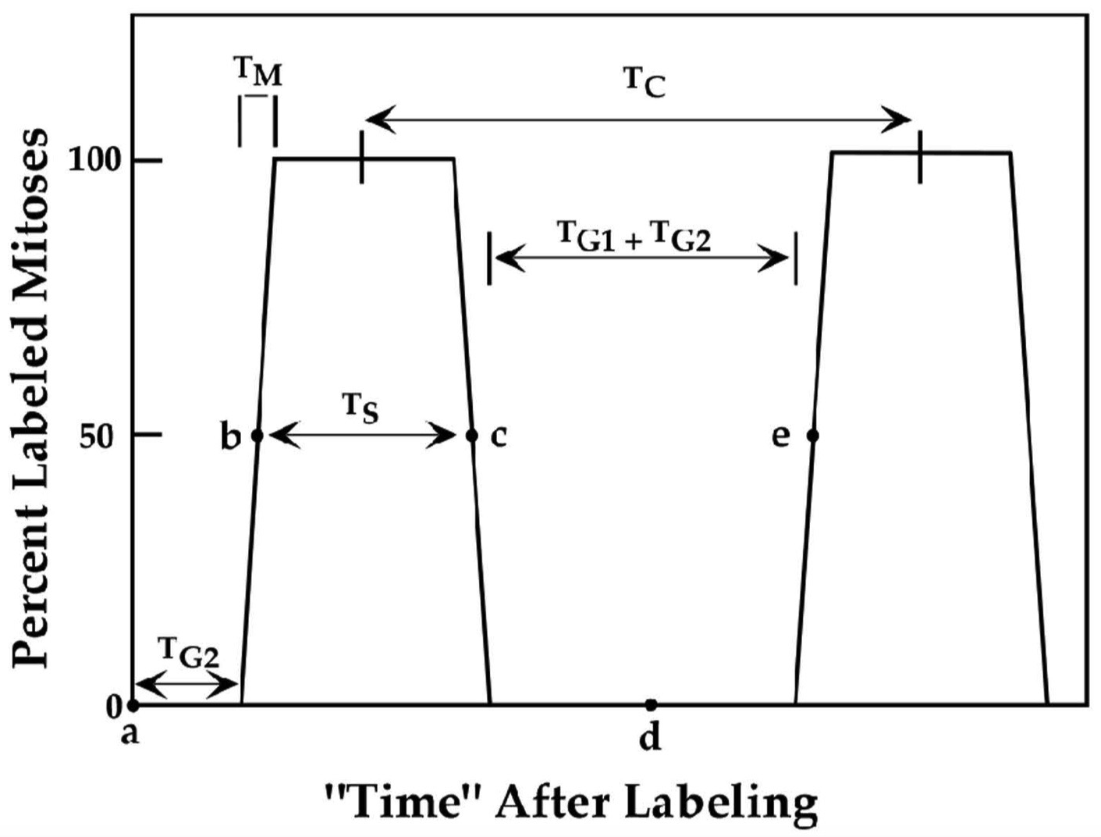
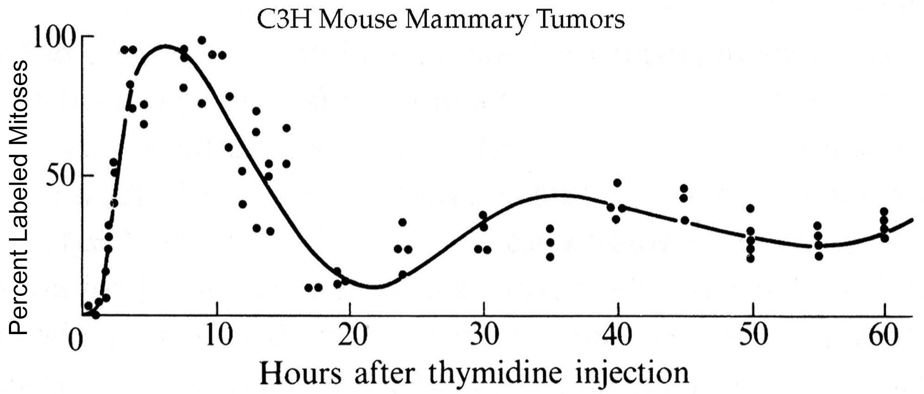

Slide 59
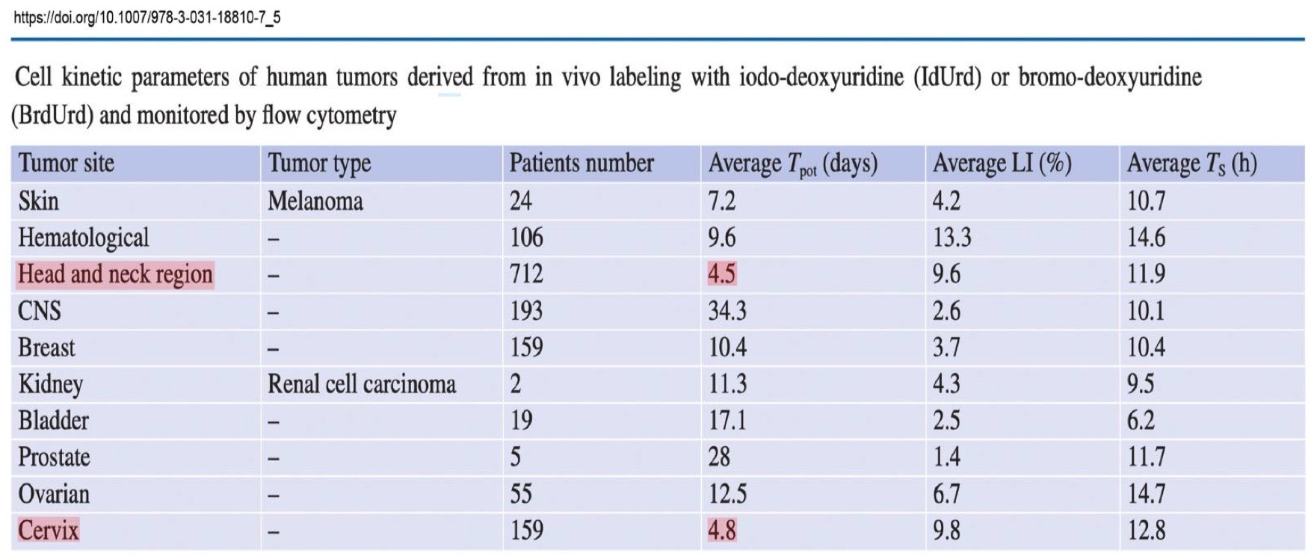
The Tpot for many head and neck cancers is in the range of:
A. 1-2 days
B. 3-5 days
C. 6-10 days
D. 25-40 days
E. ≥50 days

Slide 60
Which statement about cancer stem cells (CSCs) is FALSE?
A. CSCs can both self-renew and give rise to progenitor cells.
B. HIF-1 plays a role in maintaining the “stemness” of CSCs.
C. CSCs may be responsible for therapeutic resistance.
D. CSCs proliferate rapidly.
E. CSCs reside in hypoxic niches.

Slide 61
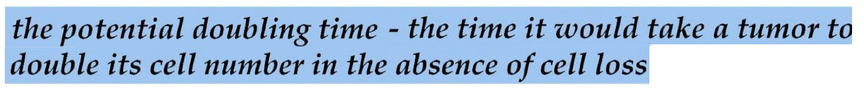
The Tpot for a tumor can be calculated from the cell cycle time of the cells comprising the tumor, the tumor’s growth fraction, and based on the assumption that the cell loss factor is:
A. 0
B. 0.2
C. 0.6
D. 1.0

Slide 62
Which statement is TRUE concerning the cell cycle kinetics of human tumors?
A. The growth fraction of a tumor represents the proportion of cells capable of transplanting the tumor.
B. A tumor's growth rate generally increases with increasing tumor size.
C. The rate of cell loss is usually the major factor that determines a tumor’s volume doubling time.
D. A tumor's volume doubling time is largely determined by the cell cycle times of its constituent cells.

Slide 63
Which statement about cell loss from tumors is TRUE?
A. Distant metastases develop from many of the ”lost” cells.
B. The cell loss factor is determined using pulse labelling of S phase cells.
C. Tumors with high cell loss rates tend to regress slowly after irradiation.
D. Cell loss factors for some human carcinomas can be as high as 90%.

Slide 64
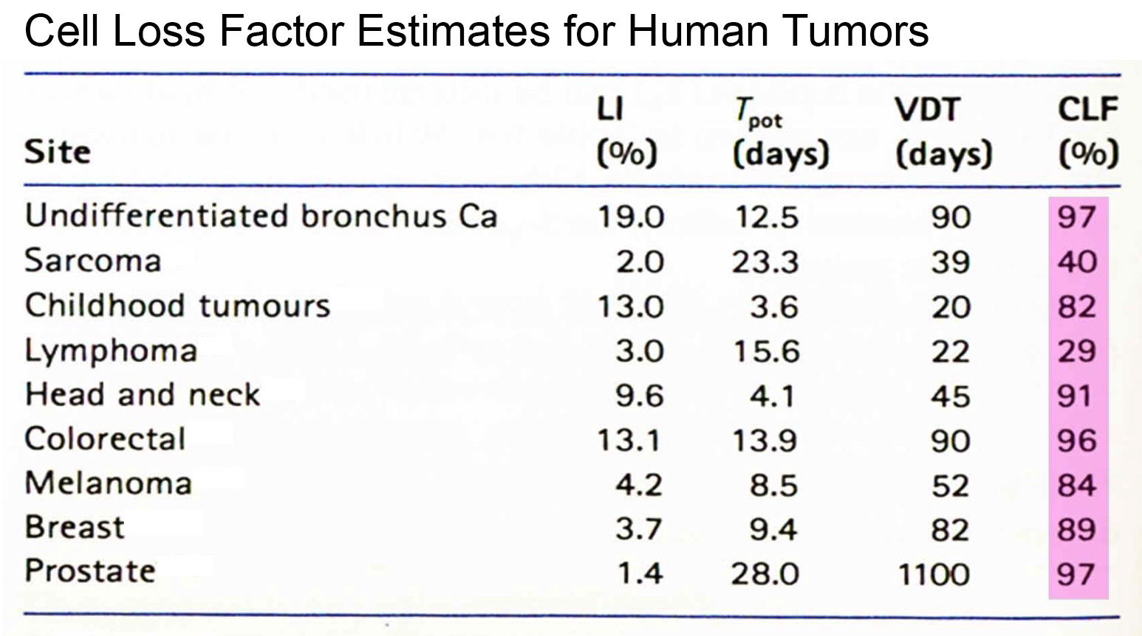

Slide 65
Using the Rubin and Cassarett tissue classiﬁcation system, which is the correct sequence of cell types from most radioresistant to most radiosensitive?
A. vegetative intermitotic / differentiating intermitotic / reverting postmitotic / ﬁxed postmitotic
B. differentiating intermitotic / vegetative intermitotic / reverting postmitotic / ﬁxed postmitotic
C. reverting postmitotic / ﬁxed postmitotic / differentiating intermitotic / vegetative intermitotic
D. ﬁxed postmitotic / reverting postmitotic / differentiating intermitotic / vegetative intermitotic

Slide 66
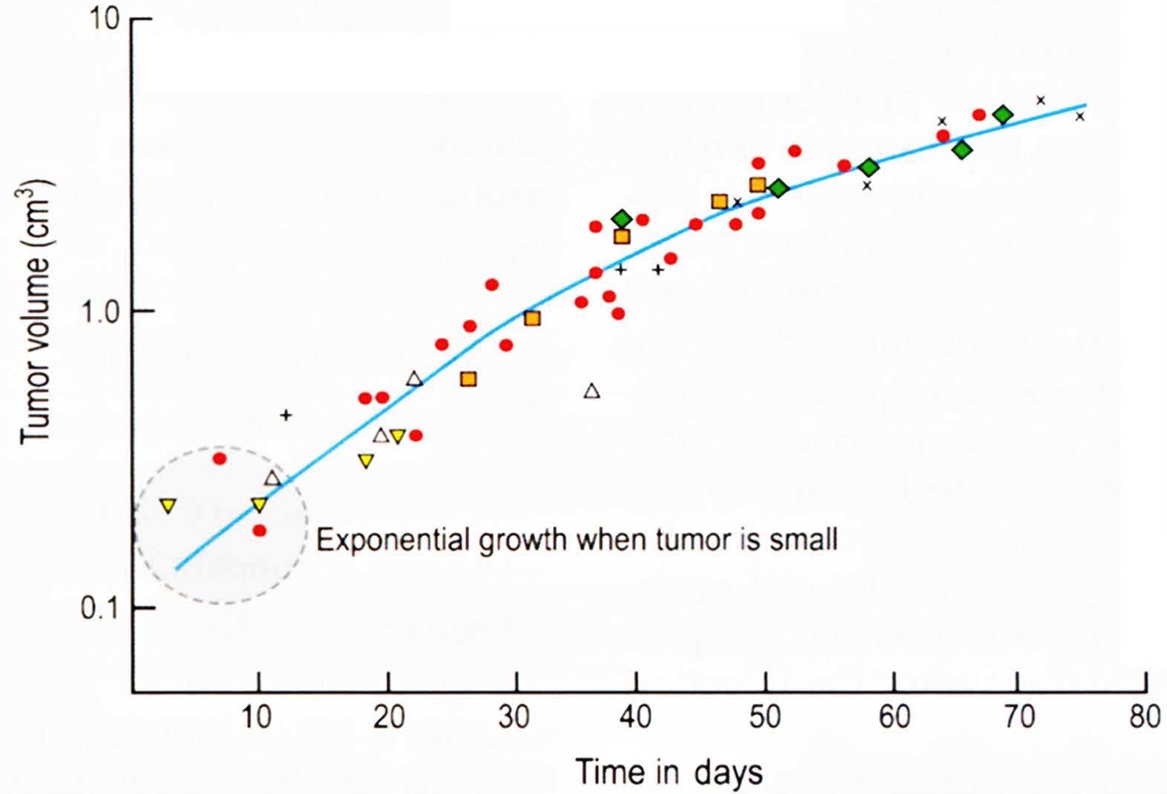
What is the typical shape of a solid tumor growth curve?
A. linear
B. linear-quadratic
C. exponential
D. Gompertzian
E. sigmoid

Slide 67
How would a tumor with a short cell cycle time, a low growth fraction and a high cell loss rate behave before and in response to radiation therapy?
A. grow slowly / regress rapidly
B. grow slowly / regress slowly
C. grow rapidly / regress slowly
D. grow rapidly / regress rapidly

Slide 68
Which set of tumor kinetic parameters is correctly ordered from shortest to longest duration? (Abbreviations: Tc = cell cycle time; Td = tumor volume doubling time; Tpot = tumor potential doubling time; Ts = duration of S phase)
A. Ts < Tc < Td < Tpot
B. Ts < Tc < Tpot < Td
C. Ts < Tpot < Tc < Td
D. Tpot < Ts < Tc < Td

Slide 69
What is the approximate range of cell cycle (Tc) and volume doubling (Td) times for human carcinomas?
A. Tc, 1 to 5 days and Td, 20 to 30 days
B. Tc, 1 to 5 days and Td, 60 to 100 days
C. Tc, 0.1 to 1 days and Td, 60 to 100 days
D. Tc, 1 to 5 days and Td, 120 to 300 days

Slide 70
True-False Questions
Mitotic activity in a tissue roughly predicts when it will respond to radiation, but not if or how severely.
True
It would take approximately 60 cell doublings before a solid tumor arising from a single cell becomes clinically detectable.
False

Slide 71
Early & Late Effects

Slide 72
The time to death from the gastrointestinal syndrome is:
A. <1 day
B. 1-3 days
C. 7-10 days
D. 20-30 days
E. 60-90 days

Slide 73
What feature of radiation-induced cataracts differs from age-related cataracts? Radiation-induced cataracts:
A. form in the deep central part of the lens.
B. occur peripherally rather than centrally.
C. also increase intra-ocular pressure.
D. resolve within a decade of irradiation.

Slide 74
Which is the correct temporal sequence for the appearance of the stated radiation effect on peripheral blood components?
A. lymphocytopenia, granulocytopenia, thrombocytopenia, anemia
B. anemia, lymphocytopenia, granulocytopenia, thrombocytopenia
C. granulocytopenia, thrombocytopenia, anemia, lymphocytopenia
D. lymphocytopenia, thrombocytopenia, anemia, granulocytopenia

Slide 75
Following total body irradiation with an acute dose of 10 Sv, which normal tissue reaction/complication would manifest the earliest?
A. breakdown of villi in the gut
B. lung ﬁbrosis
C. male sterility
D. moist desquamation of the skin
E. paraplegia

Slide 76
During the first 2 weeks of gestation, radiation exposure of an embryo usually causes:
A. growth retardation.
B. intellectual impairment(s).
C. microcephaly.
D. congenital malformation(s).
E. embryonic death.

Slide 77
Which teratogenic effect would be most likely following an X-ray dose of 1 Gy to a fetus during the 13th week of gestation?
A. microcephaly B. low birth weight
C. intellectual impairment(s)
D. gross congenital malformations

Slide 78
What would NOT be expected in an individual who received an acute, whole-body dose of 4 Sv and received no medical care?
A. infection B. nausea
C. bleeding
D. death within a week
E. epilation

Slide 79
In the absence of medical intervention, what is the approximate human LD_{50/60} (for X-rays)?
A. 1-2 Gy
B. 3-4 Gy
C. 5-6 Gy
D. 7-8 Gy

Slide 80
An employee working in a nuclear power plant is accidentally exposed to a total body γ-ray dose of 2 Gy. A week after the accident, what changes in peripheral blood counts would be expected?
A. a decrease in hemoglobin concentration and platelet counts
B. a decrease in platelet count and an increase in lymphocyte count
C. a decrease in lymphocyte counts, but no effect on hemoglobin concentration
D. no effect on lymphocytes, hemoglobin or platelets

Slide 81
A fetus that receives 250 mSv during the 29th week of gestation is at an elevated risk for:
A. congenital malformations
B. microcephaly
C. carcinogenesis
D. prenatal death

Slide 82
Within a day of an accidental whole body radiation exposure at a nuclear power plant, 8 workers develop severe, bloody diarrhea. Assuming 3 of the workers are female and 5 male, what is their likely prognosis?
A. All will survive but will be at an increased risk of cancer.
B. Approximately 50% will survive.
C. They will all die within 2 weeks of irradiation.
D. The men will be sterilized, but the women will remain fertile.

Slide 83
Which statement is TRUE concerning radiation effects on the gonads of males versus females?
A. Males can be permanently sterilized by an acute dose of 2 Gy.
B. Pre-pubertal females can be sterilized by an acute dose of 2 Gy.
C. There is no dose fractionation eﬀect in males or females.
D. The dose to cause sterility in females is age dependent.

Slide 84
The wide spectrum of potential teratogenic effects is due primarily to:
A. the sex of the irradiated embryo/fetus.
B. innate differences in the radiosensitivity of different cells in the embryo/fetus.
C. which organs were actively developing at the time of irradiation.
D. maternal age at conception.

Slide 85
Which is NOT a possible long-term complication of TBI in preparation for a bone marrow transplant?
A. cataracts
B. second malignancies
C. pulmonary insufficiency
D. low testosterone in men
E. ovarian dysfunction in women

Slide 86
Which statement concerning radiation-induced cataracts is TRUE?
A. The lens of the eye can eliminate cells damaged by radiation.
B. There is a shorter latency period for cataracts following a large radiation dose than a small one.
C. The neutron RBE for cataract formation following irradiation with multiple small doses is approximately 1.5.
D. For single doses, the threshold for a radiation-induced cataract is 15 Gy.

Slide 87
True-False Questions
Bone marrow transplants saved the lives of most of the Chernobyl emergency responders who were suffering from acute radiation sickness.
False
During the most sensitive phase of gestation, the risk of intellectual impairment in an irradiated embryo or fetus may be as high as 4% per Sv.
False

Slide 88
True-False Questions (cont.)
A person who receives a whole body, acute dose of 10 Sv will die secondary to bone marrow ablation.
False
Radiation pneumonitis usually occurs 2-4 months after the completion of radiotherapy.
True

Slide 89
Normal Tissue Tolerance

Slide 90
The TD_{5/5} as a function of length of spinal cord irradiated:
A. decreases as a linear function of increasing cord length.
B. initially decreases with increasing cord length, and then plateaus for higher total doses.
C. increases steeply for cord lengths greater than approximately 10 cm.
D. decreases with decreasing cord length.

Slide 91
Which statement is FALSE concerning cytokines?
A. bFGF facilitates radiation-induced apoptosis of vascular endothelial cells.
B. High levels of TGFβ1 are associated with an increased risk of pulmonary ﬁbrosis following radiotherapy.
C. IL-1 is a bone marrow radioprotector.
D. A paracrine response involves one cell producing cytokines that affect nearby cells.

Slide 92
In the ______, provided ~3 months have passed since the initial treatment, 90-100% of the full dose can be delivered a second time.
A. dermis
B. epidermis
C. lung
D. kidney
E. spinal cord

Slide 93
The expert consensus panel that has proposed dose constraints for hypofractionation is known by which acronym?
A. LENT-SOMA
B. QUANTEC
C. HyTEC
D. PENTEC
E. CTCAE

Slide 94
The inhibition of which protein reduces pulmonary fibrosis in rodents?
A. Ki-67
B. RIP-1
C. Calreticulin
D. SMAD3
E. WNT

Slide 95
All are pro-ﬁbrotic cytokines, EXCEPT:
A. bFGF
B. IL-6
C. TGF-β
D. TNF-α

Slide 96
Which statement about the reirradiation tolerance of the spinal cord is TRUE?
A. The time between the initial radiation course and the retreatment course is inversely proportional to the incidence of myelopathy.
B. The spinal cord can be reirradiated to full dose provided the time interval between treatments is at least 6 months.
C. Reirradiation data from primates and humans suggest that spinal cord tolerance begins to improve only when there is at least 2 years between treatments.
D. The spinal cord cannot be reirradiated due to persistent, subclinical damage from the initial radiation course.

Slide 97
Which statement concerning radiation-induced late effects is TRUE?
A. Most late effects develop because of endothelial cell killing.
B. Most late effects develop because of parenchymal cell killing.
C. Radiation-induced late effects produce unique pathological responses.
D. The development of late effects shares elements in common with normal wound healing.

Slide 98
Which normal tissue would show the least amount of sparing when irradiated with X-rays at a high versus low dose rate?
A. bone marrow
B. breast
C. kidney
D. lung
E. spinal cord

Slide 99
Which statement regarding the relationship between total dose and the volume of tissue irradiated is FALSE?
A. In the skin, migration of surviving clonogenic cells from neighboring functional subunits (FSUs) helps explain the higher tolerance dose when small volumes are irradiated.
B. FSUs of the skin are arranged in series and have a linear tolerance dose versus treatment volume relationship.
C. The radioresponse of the spinal cord is consistent with a serial arrangement of FSUs.
D. The kidney and lung are normal tissues in which FSUs are arranged in parallel.

Slide 100
Which cell death mechanism contributes to the development of radiation-induced lung ﬁbrosis?
A. (pre-mitotic) apoptosis
B. necrosis
C. pyroptosis
D. senescence

Slide 101
The organ/tissue least able to tolerate re-irradiation is the:
A. spinal cord.
B. oral mucosa.
C. lung.
D. liver.
E. kidney.

Slide 102
True-False Questions
The cyclic generation of reactive oxygen species and proinﬂammatory cytokines in irradiated normal tissues contribute to the development of late complications.
True
The functional subunit (FSU) hypothesis is a simplistic model to explain the treatment volume dependency of radiation-induced complications.
True

Slide 103
True-False Questions (cont.)
The putative function subunits of the urethra are arranged in series.
True
Late complications in normal tissues often occur sooner after an initial course of radiotherapy than after a retreatment course.
False

Slide 104
4Rs of Radiotherapy

Slide 105
Which of the four Rs of radiotherapy will increase cell survival during fractionated radiotherapy?
A. redistribution and repair
B. redistribution and reoxygenation
C. reoxygenation and repopulation
D. repair and repopulation

Slide 106
Which radiobiological process causes the inverse dose rate effect?
A. repair of sublethal damage
B. repair of potentially lethal damage
C. accumulation of cells in S phase
D. redistribution
E. repopulation

Slide 107
For a conventional course of radiotherapy, which tumor characteristic would improve tumor control?
A. high SF2
B. incomplete reoxygenation
C. long Tpot
D. large number of tumor clonogens
E. early onset of repopulation

Slide 108
For an asynchronous population of cells irradiated with 4 Gy of X-rays, the cell cycle distribution of surviving cells 24 hours later is:
A. enriched with S phase cells.
B. enriched with G2 and M phase cells.
C. depleted of G1 phase cells.
D. relatively unchanged.

Slide 109
For a large solid tumor, which strategy most likely would improve the therapeutic ratio?
A. stimulation of repair in hypoxic cells
B. stimulation of repopulation in hypoxic cells
C. inhibition of repair in aerobic cells
D. radioprotection of aerobic cells
E. inhibition of reoxygenation

Slide 110
Patients receiving twice daily radiotherapy typically receive their two dose fractions no less than 6 hours apart. This is done to maximize:
A. cell cycle redistribution in normal tissues.
B. reoxygenation of hypoxic cells in normal tissues.
C. repair of sublethal damage in normal tissues.
D. repair of sublethal lethal damage in tumors.
E. repopulation in normal tissues

Slide 111
True-False Questions
Concerning the 4-6 Rs of radiotherapy:
Reoxygenation of human tumors can occur over
minutes, hours or days.
True
Daily irradiation of mouse skin induces a delayed, but then rapid, proliferative response.
True

Slide 112
True-False Questions (cont.)
Concerning the 4-6 Rs of radiotherapy:
Incomplete repair will increase the tolerance dose for a particular complication in a normal tissue.
False
The inverse dose rate effect is well-documented
in vivo.
False

Slide 113
True-False Questions (cont.)
Concerning the 4-6 Rs of radiotherapy:
In the absence of repopulation, there is a fraction size below which no further tissue sparing occurs.
True
A tumor’s ”radiosensitivity index” (RSI) is based on gene expression patterns that correlate with SF₂.
True

Slide 114
True-False Questions (cont.)
The incidence of late normal tissue reactions after radiotherapy is influenced by:
Fraction size
True
Time between fractions
True
Overall treatment time
False

Slide 115
True-False Questions (cont.)
The incidence of late normal tissue reactions after radiotherapy is influenced by:
Total dose
True
Planned treatment interruption
False

Slide 116
LQ Isoeffect Model

Slide 117
What is the biological rationale for accelerated hyperfractionation?
A. reduce the tumor’s hypoxic fraction
B. reduce early reactions in normal tissues
C. decrease late effects while increasing tumor control
D. radiosensitize tumor cells
E. increase tumor immunogenicity

Slide 118
Assume a tumor is characterized by an α/β ratio of 2 Gy and the corresponding dose-limiting normal tissue is characterized by an α/β ratio of 4 Gy. In the absence of cell proliferation during treatment, which treatment schedule would most likely yield the highest therapeutic ratio?
A. standard fractionation
B. accelerated fractionation
C. split-course treatment
D. hyperfractionation
E. hypofractionation

Slide 119
Which statement concerning α/β ratios for tumors and normal tissues is TRUE?
A. The α/β ratio is generally low for early responding tissues and high for late responding tissues.
B. The α/β ratio corresponds to the dose at which the dose response curve ﬁrst begins to bend and deviate from its initial slope.
C. In vivo, α/β ratios for normal tissues and tumors are obtained using isoeffect data from multi-fraction experiments.
D. The α/β ratio tends to be low for tumors with a pro-apoptotic tendency.

Slide 120
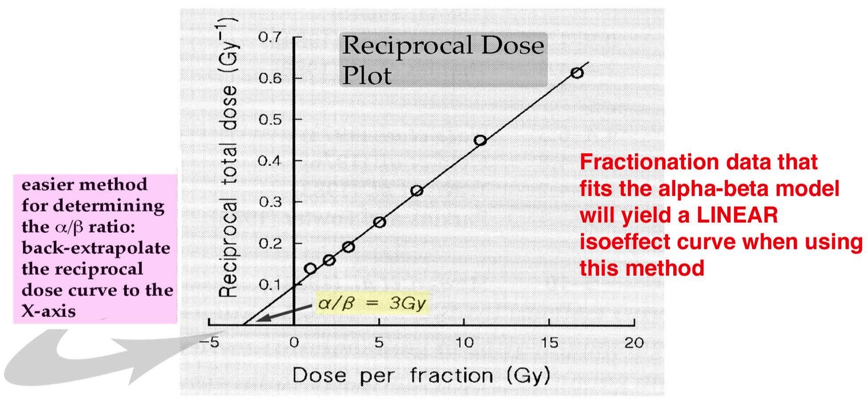
A reciprocal dose plot is used to calculate a tissue's:
A. Tpot.
B. α/β ratio.
C. repair half-time.
D. growth fraction.
E. cell loss factor.

Slide 121
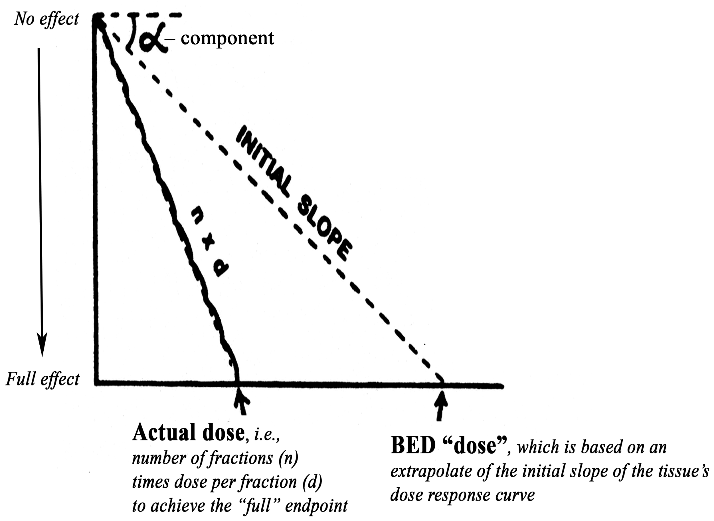
BEDs are:
A. doses.
B. extrapolated doses.
C. equivalent doses.
D. isoeffective doses.
E. dose reduction factors.

Slide 122
Tumors A and B are characterized by α/β ratios of 2 Gy and 30 Gy, respectively. For single doses, both tumors have the same TCD₉₀. If these tumors are both treated with daily 2 Gy fractions in approximately the same overall treatment time, how will the TCD₉₀ for tumor A change relative to that for tumor B?
A. increase
B. decrease
C. no change

Slide 123
Assuming no differences in overall treatment time, which statement is TRUE concerning isoeffect curves?
A. Tissues with a greater repair capacity have steeper isoeffect curves.
B. Increased repopulation of tumor cells during radiotherapy will decrease the slope of the isoeffect curve.
C. Tissues with steep isoeffect curves have high α/β ratios.
D. Isoeffect curves for tumor control will be steeper if reoxygenation occurs between doses.

Slide 124
Two isoeffect curves, one corresponding to a given probability of tumor control and the other to a given probability of a late complication in a critical normal tissue, are found to intersect. The most important application of this information would be to predict the:
A. tumor control probability.
B. optimal range of fraction sizes to use for treatment.
C. optimal overall treatment time.
D. normal tissue complication probability.
E. shapes of the underlying tissue dose response curves.
Notes:
tis

Slide 125
Which fractionation scheme should produce the highest incidence of late effects in a tissue characterized by an α/β ratio of 3 Gy?
A. 30 fractions of 2.0 Gy in 6 weeks
B. 4 fractions of 7.25 Gy in 4 weeks
C. 16 fractions of 3.3 Gy in 6 weeks
D. 60 fractions of 1.2 Gy in 5 weeks
E. 30 fractions of 2.3 Gy in 6 weeks
Solution:
1. Realize that the overall treatment time doesn’t matter in the case of late effects.
2. Resist urge to assume that “B” must be the right answer just because it employs the highest dose per fraction. The total dose contributes to the BED as well.
3. Calculate the BEDs for each treatment…highest one wins!
e.g., BED = 60 Gy (1 + 2 Gy/fxn) = 100 Gy₃
3 Gy

Slide 126
A. 30 fractions of 2.0 Gy in 6 weeks 100 Gy₃
B. 4 fractions of 7.25 Gy in 4 weeks 99.1 Gy₃
C. 16 fractions of 3.3 Gy in 6 weeks 80.6 Gy₃
D. 60 fractions of 1.2 Gy in 5 weeks 100.8 Gy₃
E. 30 fractions of 2.3 Gy in 6 weeks 121.4 Gy₃

Slide 127
Accelerated fractionation is used to:
A. counteract the inherent radioresistance of some tumor cells.
B. decrease the potential for tumor cell repopulation.
C. overwhelm DNA repair processes in tumor cells.
D. overcome the radioresistance of hypoxic tumor cells.
E. increase the potential for repopulation by cells in normal tissues.
Notes:
tis

Slide 128
Which total dose, given as 1.5 Gy fractions, is approximately equivalent to a conventional schedule of 30 fractions of 2 Gy for late normal tissue reactions? (Assume the tissue’s α/β ratio is equal to 3 Gy.)
A. 53 Gy
B. 60 Gy
C. 67 Gy
D. 75 Gy
E. 81 Gy
Solution:
For the same probability of late complications:
60 Gy (1 + 2 Gy/fxn) = D (1 + 1.5 Gy/fxn)
3 Gy 3 Gy
100 Gy₃ = 1.5 x D ---> D = 66.7 Gy ≈ 67 Gy

Slide 129
Microbeam radiotherapy delivers the dose ___________, whereas FLASH radiotherapy delivers the dose ___________.
A. non-uniformly in volume / non-uniformly in time
B. non-uniformly in time / at a very high dose rate
C. at a very high dose rate / non-uniformly in volume
D. non-uniformly in volume / at a very high dose rate

Slide 130
Which statement is TRUE concerning a tissue with an α/β ratio of 10 Gy?
A. The tissue would be spared preferentially by hyperfractionation compared to a tissue with a lower α/β ratio.
B. The dose response curve for this tissue would bend more gradually than if the α/β ratio had been 3 Gy.
C. This α/β ratio is more characteristic of late-responding normal tissues.
D. Most tumors have an α/β ratio less than 10 Gy.

Slide 131
The CHART clinical trial in head and neck cancer incorporated all of the following, EXCEPT:
A. short overall treatment time
B. three fractions per day
C. total doses of 50 – 55 Gy
D. low doses per fraction
E. concurrent chemotherapy

Slide 132
A treatment schedule consisting of 25 daily fractions of 1.8 Gy was found to be (clinically) equivalent to a schedule consisting of 17 daily fractions of 2.5 Gy with respect to complication probability in a critical normal tissue. What is the approximate α/β ratio for this tissue?
Solution:
For the same probability of a complication:
BED₁ = 45 x (1 + 1.8 / α/β) = BED₂ = 42.5 x (1 + 2.5 / α/β)
45 + (81 / α/β) = 42.5 + (106 / α/β) → α/β = 10.1 Gy
A. 3 Gy
B. 5 Gy
C. 7 Gy
D. 10 Gy

Slide 133
The tolerance dose for xerostomia resulting from treatment of a head and neck cancer with 3 Gy fractions compared to 2 Gy fractions would:
A. increase slightly
B. increase moderately
C. decrease slightly
D. decrease moderately
E. remain unchanged
Trick question!
Can’t be more specific than this because the α/β ratio isn’t specified.
If α/β is quite low, then the answer would be “D”, but if it’s somewhat higher, then the answer would be “C”.

Slide 134
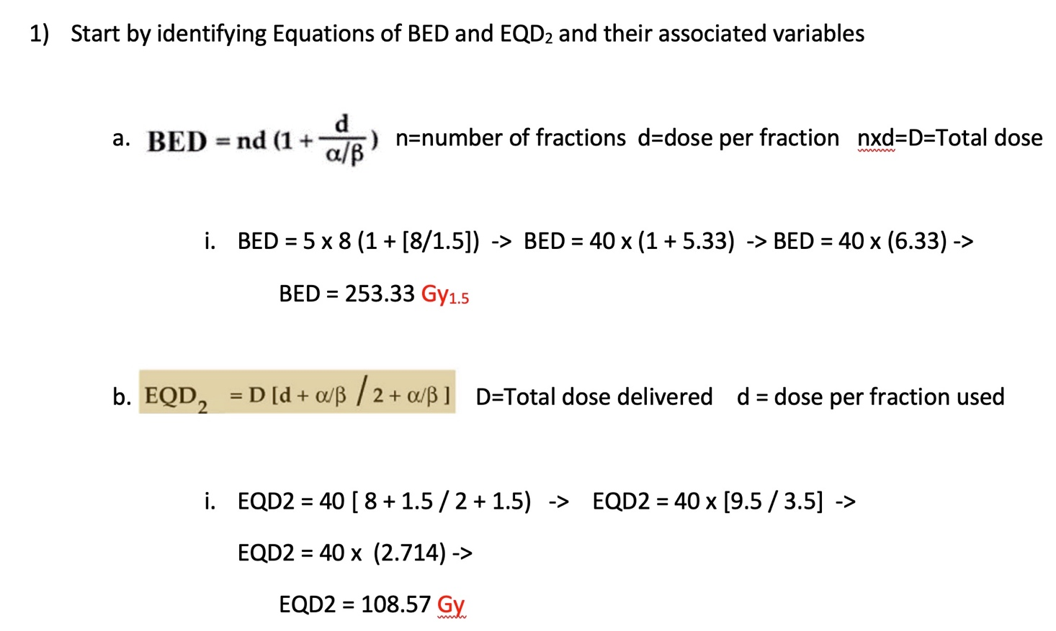
What are the BED and EQD₂, respectively, for a treatment that delivers 40 Gy in 5 fractions to a prostate cancer with an α/β ratio of 1.5 Gy?
(Assumptions: sufficient time for repair; no repopulation; full oxygenation)
A. 173 Gy_{1.5} / 74 Gy
B. 213 Gy_{1.5} / 91 Gy
C. 253 Gy_{1.5} / 109 Gy
D. 303 Gy_{1.5} / 130 Gy

Slide 135
A patient with cervical cancer is treated conventionally, 35 fractions of 2 Gy to a total dose of 70 Gy. Which alternate treatment schedule would yield approximately the same probability of a late complication? (Assume the organ-at-risk’s α/β ratio is 3 Gy.)
A. 22 fractions of 3 Gy
B. 75 fractions of 1.2 Gy
C. 18 fractions of 3.5 Gy
D. 48 fractions of 1.6 Gy
Solution:
For the same probability of a late complication:
BED₁ = 70 Gy x (1 + 2/3) = 116.7 Gy₃
BED₂ = 76.8 Gy x (1 + 1.6/3) = 117.7 Gy₃

